Slide 1
Object Oriented Programming in C++

Slide 2
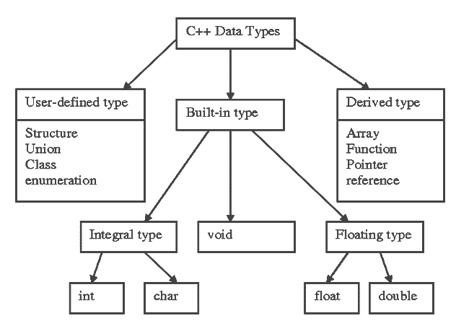
User Types
http://tutorialink.com/cpp/basic-data-types.cpp

Slide 3
Classes
Classes are user-defined types (similar to structs)
Consists of a set of data members (variables, constants and functions)
Classes can have some important functions for the purposes:
Object initialization
Copy
Move
and object destruction
Members are accessed with the . operator for objects, and -> for pointers
Operators like +, !, and [] can be defined for a class
Classes are defined by the keyword class, which is like a namespace for its members
class CyberBullet{
double velocity, position;
double time_to_target_at(double target_position) {
return (target_position – position) / velocity;
}
};

Slide 4
Class vs Struct
Class members are private by default
Struct members are public by default
Syntactically they are very similar
class CyberBullet{
double velocity, position;
double time_to_target_at(double target_position) {
return (target_position – position) / velocity;
}
};
struct CyberBullet {
double velocity, position;
double time_to_target_at(double target_position){
return (target_position – position) / velocity;
}
};

Slide 5
Member Functions
C++ classes can (and usually do) have member functions
These are just like the free functions you know from C, except they can access all of the classes other data members
If defined outside the class namespace, you must use the scope resolution operator
In OOP, member functions are also known as methods
class CyberBullet{
double velocity, position;
double time_to_target_at(double target_position) {
return (target_position – position) / velocity;
}
};
double CyberBullet::time_to_target_at(){…}

Slide 6
Instance vs Class Members
We are more familiar with instance members of a class. That is parts of a class that pertain to a particular instance object.
Using the static keyword, we can specify that variables or methods be shared across all instances of a class .
This is now known as a class member
This is valuable for performing actions that affect the state of all objects of a class in your system
class CyberBullet{
static int bulletCount;
double velocity, position;
double time_to_target_at(double target_position) {
return (target_position – position) / velocity;
}
};
CyberBullet::bulletCount = 150;

Slide 7
Don’t give me static!
Static methods do not require that any objects of a class even exist.
Static methods cannot access its class instance methods or data. Can only access other static members
All static elements are allocated in a special static storage area in memory, not on the stack.
So they are allocated when they brought into scope, deallocated when out of scope.
Scope enters at program startup, exits on program exit.
class CyberBullet{
static int bulletCount;
double velocity, position;
double time_to_target_at(double target_position) {
return (target_position – position) / velocity;
}
static int Reload(){
bulletCount = 30;
}
};
double CyberBullet::time_to_target_at(){…}

Slide 8
Access Specifiers
Sometimes you don’t want users of your class to be able to access with its members
There are access specifiers you can use in these situations
public: all access pass
protected: only class and subclasses can access
private: only this class can access; classes and functions marked friend can also access
Generally, your class member variables are marked private or protected
Class functions are typically marked public, and provide access to your member variables
This methodology is known as data encapsulation
Why is this scheme a good idea?

Slide 9
Classes vs Structs
struct CyberBulletStruct{
double time_to_target_at(double target_position);
private:
double velocity, position;
};
class CyberBulletClass1 {
double velocity, position;
public:
double time_to_target_at(double target_position);
};
class CyberBulletClass2 {
public:
double time_to_target_at(double target_position);
private:
double velocity; position;
};

Slide 10
Object Lifecycle
One of the most powerful aspects of C++ is the object lifecycle model
This refers to when an object is instantiated, and when the object’s resources are released
In C/C++, this CyberBullet is put in the stack frame of fn() here:
When is this CyberBullet allocated/deallocated?
void fn() {
CyberBullet cb;
}

Slide 11
Object Lifecycle
And on the heap here:
Recall that in C, malloc returns allocated memory of a given size from the heap in a pointer.
In C++, this object is constructed with a constructor, specifically…CyberBullet’s constructor.
The constructor is called with the new operator, and must be paired with a delete operator. Why?
//C-style
CyberBullet *a = (CyberBullet*) malloc(sizeof(CyberBullet));
//C++ style
auto a = new CyberBullet();

Slide 12
Constructors
Constructors are special member functions that initialize objects
They do not have any return type.
A class can have many different constructors, each with a unique argument list
An object begins its life with a call to a constructor
The this keyword is a pointer used to refer to the instance of the class being called.
class CyberMissile {
double range, warhead;
public:
CyberMissile(double range, double warhead){
this->range = range;
this->warhead = warhead;
}
void fire();

Slide 13
Member Objects
Member objects are constructed before an owning object is constructed.
#include <iostream>
class CyberEngine {
public:
CyberEngine(){
printf(“Engine is ready!”);
};

Slide 14
Member Objects
struct CyberJet {
CyberJet() {
printf(“Jet is ready\n”);
}
CyberEngine ce;
};
int main() {
CyberJet jet;
return 0;
}

Slide 15
List Initialization
There are still more ways to construct C++ objects.
You can use list initialization with braces rather than parenthesis when calling the constructor.
List initialization can help protect you from narrowing conversions.
Be careful when your user defined data type accepts std::initializer_list as a constructor parameter. Do not use list initialization in this case. (e.g. std::vector)
CyberMissile missile1 {100, 50};
CyberMissile missile2 = {100, 50};
auto missile3 = CyberMissile{100, 50};

Slide 16
Member Lists
In your class, you can initialize class members with direct initialization
This is more efficient than using assignment operators inside the constructor body
class CyberMissile {
double range, warhead;
public:
CyberMissile(double arg_range, double arg_warhead): range(arg_range), warhead(arg_warhead){}
void fire();

Slide 17
Narrowing Conversions
void fun(double val, int val2) {
int x2 = val; // if val==7.9, x2 becomes 7 (bad)
char c2 = val2; // if val2==1025, c2 becomes 1 (bad)
int x3 {val}; // error: possible truncation (g00d)
char c3 {val2}; // error: possible narrowing (g00d)
char c4 {24}; // OK: 24 can be represented exactly as a char
// (g00d)
char c5 {264}; // error: (assuming 8-bit chars): 264 cannot be
//represented as a char (good)
int x4 {2.0}; //error: no double to int value conversion //(g00d)
}

Slide 18
Destructors
Destructors are special member functions that are called when an object’s lifetime ends
Recall: Member objects are constructed before an owning object is constructed. Destructors are applied in reverse order
The purpose of the destructor is to release resources that the object is responsible for.
Like constructors, destructors have no return type. They are instead preceded by the ~
Classes are allowed only one destructor
Destructors are amazing, and you should use them. And love them. And make shrines to their amazingness.

Slide 19
Destructors
#include <stdlib.h>
#include <stdio.h>
class File {
public:
File(const char *file_name, const char *mode) {
raw_file = fopen(file_name, mode);
}
~File() {
fclose(raw_file);
}
void write(const char *input) {
fprintf(raw_file, “%s”, input);
private:
FILE *raw_file;
};
main() {
File x(“foo”, “w+”);
x.write(“Hello, world!”); }

Slide 20
Destructors
Lets deconstruct whats going on
What happens to the File object upon return?
int main() {
File x(“foo”, “w+”);
//Do stuffs
if (something_bad_happened)
return ERROR
//Do more stuffs
return SUCCESS;
}

Slide 21
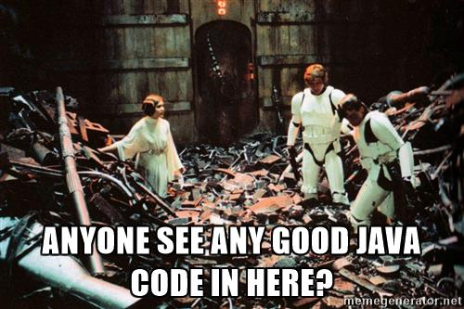
Who needs garbage collection?
Garbage collection is neither necessary nor sufficient for quality software.- Bjarne Stroustrup, Herb Sutter, and Gabriel Dos Reis
If Java had true garbage collection, most programs would delete themselves upon execution. -- Robert Sewell

Slide 22
const functions
Functions marked const are guaranteed not to modify the object’s state:
The is_hungry() function doesn’t modify a CyberWarrior’s state, so we can mark it as const.
class CyberWarrior {
public:
bool is_thirsty() const {
return thirsty;
}
void beer_me() {
thirsty = true;
}
private:
bool thirsty;
};

Slide 23
const functions
void check_status(const CyberWarrior &warrior) {
auto x = warrior.is_thirsty(); //OK!
//warrior.beer_me(); // won’t compile
}
void beer_thirsty_warrior(CyberWarrior &warrior) {
if(warrior.is_thirsty())
warrior.beer_me(); //OK, warrior is not const
}
The is_hungry() function doesn’t modify a CyberRanger’s state, so we mark it as const.

Slide 24
BFFs
Recall that private (and protected) members of a class cannot be accessed from the outside (unless they are friends <3)
The friend keyword can be applied to both functions and classes to allow access to private members
class Polygon {
protected:
int width, height;
public:
void set_values (int a = 0, int b = 0) {
width = a; height = b; }
friend void print_values(Polygon &poly);
friend class Geometry;
};

Slide 25
Friends
void print_values(Polygon &poly) { //Does this work?
printf(“Width: %f Height: %f \n”, poly.width, poly.height);
}
void print_values_2(Polygon &poly) { //And this one?
printf(“Width: %f Height %f \n”, poly.width, poly.height);
}
class Geometry {
Polygon poly;
public:
void set_values(int a = 0; int b = 0) {
poly.width = a; poly.height = b
};

Slide 26
Lab 4
Design a class Person, that has private data members for first name, last name, age, and gender.
Implement public functions to get and set the values of these private data members, (example: std::string getFname(), void setFname(std::string fName), as well as your constructor(s) and destructor
Inside of main.cpp, you will find the function, generate_roster() that you will need to write. This function will receive user input to populate an array of Person objects, with each person being an individual in the class roster. Return the number of students recorded.
You will also find a function called log_roster(). Write this function to print each user out to roster.txt.
Compile person.h and roster.cpp into an executable to test your work.

Slide 27
Inheritance and Polymorphism

Slide 28
Inheritance and Polymorphism
The strength of objects is the ability to group together data and functionality into a logical design
The ability to relate objects together further assists in abstracting a complex problem.
We can form hierarchies of classes, and we have two paradigms:
Interface inheritance: provides a contract that your code must comply to, both implementer and user
Implementation inheritance: simplify implementation by deriving a class from another

Slide 29
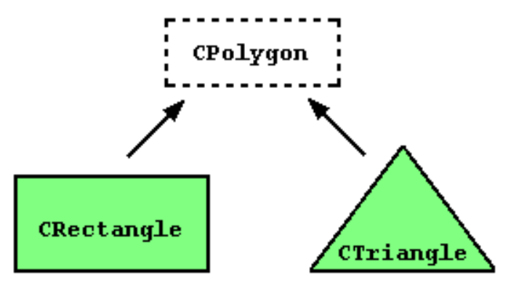
Inheritance
C++ inheritance can be complicated …
Conceptualize as an Is-A relationship (IE. An eagle is a bird)
Classes can be extended to create a derived class, which retains some characteristics of the base class.
The derived class inherits the member function and properties of the base class.
Polymorphism, (Latin: multiple-form), use one class as though it were another

Slide 30
Inheritance
class Polygon {
protected:
int width, height;
public:
void set_values (int a = 0, int b = 0) {
width = a; height = b; }
};
class Rectangle: public Polygon {
public:
int area() { return width * height; }
};
class Triangle: public Polygon {
public:
int area() { return width * height / 2; }
};
Polygon is our base class
Rectangle and Triangle derive from Polygon
The derived class inherits from the base class by using the : operator during class declaration
Only member variables and functions marked public or protected can be inherited
Rectangle and Triangle can now access the data members declared in the Polygon class
Notice too that they both Rectangle and Triangle define a function int area(), with different implementations.

Slide 31
Inheritance Design
To reiterate, inheritance allows a derived class to take on properties of its parent class
We use inheritance to make a derived class that is more specific and tailored to our purpose (I.E. – an eagle is more specific than a bird)
A function may exist in a parent class, that we need to use…but it isn’t exactly what we need
Real world example:
A bird flaps its wings in order to fly
But an eagle flaps less and uses convection currents to soar
And a hummingbird flaps its wings extremely fast in order to fly
They are all birds, and they all fly() but the implementation details will differ …

Slide 32
Virtual functions
class Logger {
public:
virtual ~Logger() { }
virtual void info(const char message[]) = 0;
virtual void error(const char message[]) = 0;
};
virtual means this method can be overridden by a subclass
=0 indicates there is no default implementation and the inheriting class must implement it
Note: because this class has only virtual functions, it is a pure virtual class. Also because this class has no definition to instantiate, only declarations…it is abstract

Slide 33
Implementing virtual classes
class ConsoleLogger : public Logger {
public:
virtual void info(const char message[]) override {
printf(“info: %s”, message);
}
virtual void error(const char message[]) override {
printf(“error: %s”, message);
}
};
We use the override keyword to specify that we are overriding the virtual function from the base class
Indicates to the compiler that the overriding function must match the function signature in the base class
Class implementing this interface “can-do” some behavior
Providing an implementation to an abstract function or class makes it concrete

Slide 34
Final
If we mark a function with final, then we cannot override it in a derived class.
If we mark an entire class as final, then the class cannot be inherited from.
New to C++11
What happens to a class’ protected members, if the class is marked as final?
class Logger {
public:
~Logger() { }
void info(const char message[]) final;
void error(const char message[]) final;
};
class Logger final
{
protected:
char message[];
…
};

Slide 35
Why use virtual classes?
void do_stuff_and_log(const Logger &logger) {
logger.info(“Doing stuff”);
}
int main() {
ConsoleLogger cl;
do_stuff_and_log(cl);
}
You can easily change the behavior of this function by implementing a new Logger
Notice what do_stuff_and_log() asks for as an argument, and what we are passing in
Example of polymorphism in action

Slide 36
Abstract classes and Interfaces
Recall from slide 31, that we had a pure virtual class, or abstract class. This class can be thought of as an interface, as it had no definitions, only declarations
Interfaces provide a sort of contract that your programs will have to abide by. Classes derived from the abstract class must implement the methods defined as virtual.
The derived class which implements the abstract class will then make the virtual methods and class concrete
Likewise, abstract classes will dictate how programs will use the classes that are derived from itself.
Think of how you interface with a car. Every make/model is different, but we interact with them largely the same.

Slide 37
Problems with Inheritance
class Vehicle {};
class Car: public Vehicle {};
class Motorcycle: public Vehicle {};
class SportsCar: public Car {};
class Truck: public Car {};
class SportBike: public Motorcycle {};
class Ferrari: public SportsCar {};
class Slingshot: public SportsCar, public SportBike {};
//Multiple inheritance
Do we really need this long inheritance chain? Could we redesign this?

Slide 38
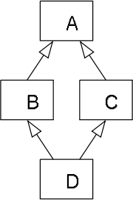
Problems with Inheritance
Out of control inheritance can lead to ambiguity
C++ allows for multiple inheritance, which leads to the “diamond problem”
Suppose A has a function overridden by B and C, but not by D
If I call the function in D,…which parent classes version of the function is called?
Take care when designing classes to avoid this…but let’s just try and avoid abusing inheritance

Slide 39
Object Composition
An object is composed of several smaller parts, an object “Has-A” other object (I.E. A car has a steering wheel)
Object composition allows us to combine many smaller, simpler parts together. We can reuse code in many places without the complexities of inheritance.
Classes are instead focused on smaller, more specific tasks

Slide 40
Composition Example
class DumbLogger {
public:
public info(const char[] x) {
printf(“info: %s”, x);
}
}
class ConsoleFoo : public DumbLogger {
public:
void do_stuff_log() {
info(“Doing stuff”);
}
}
class Foo {
void do_stuff_and_log() {
log.info(“Doing stuff”);
}
Logger &log;
}

Slide 41
Composition Example
int main(){
ConsoleLogger cl;
FileLogger fl;
Foo f;
f.log = cl;
f.do_stuff_and_log();
f.log = fl;
f.do_stuff_and_log();
…
}

Slide 42
Why pick one over the other?
Composition
Much looser coupling between classes
When we desire reusability
When we want classes to be highly focused on a particular task
Inheritance
Much more rigid, tighter coupling between classes
When we need subclasses to implement all of the characteristics of another class, but add on to it.
When we need polymorphism
Loans itself particularly well to GUI design

Slide 43
Lab 5
I have provided you with a file battle_monster.h, (totally original idea…) which contains an abstract class BattleMonster, and a class called Move
BattleMonster is abstract, and contains a number of methods that require overrides
Move is a base class that you will derive your own move classes from.
Consider creating friend functions for stab() (same_type_attack_bonus)and type_dmg_modifier()
Create your own BattleMonster, and up to 4 moves
Then write your own main() that will allow you to battle your partners’ pocket creature. Accept inputs to allow for what move to perform each turn.
Feel free to elaborate on the simple game you are making. Add new classes or features as you desire.

